Slide 1
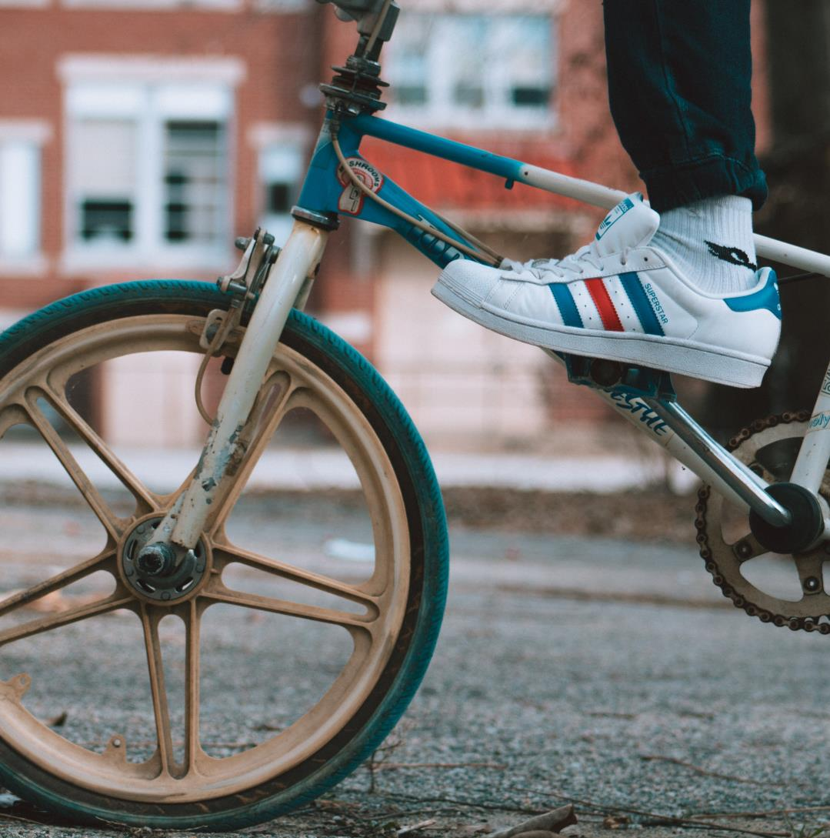

Retro
Vintage
Prepared by:
Gál Martin
Hermann Máté
Pancza Milán

Slide 2

Presentation
Our project is a website called Retro Vintage, which aims to market and sell real retro products

Slide 3
Tasks
Martin was tasked with creating the website design using the Angular framework.
Matthew created the database and the corresponding Backend code.
Milan created the documentation, the Figma Design plan and the basic coding of the Frontend in Visual Studio Code.

Slide 4
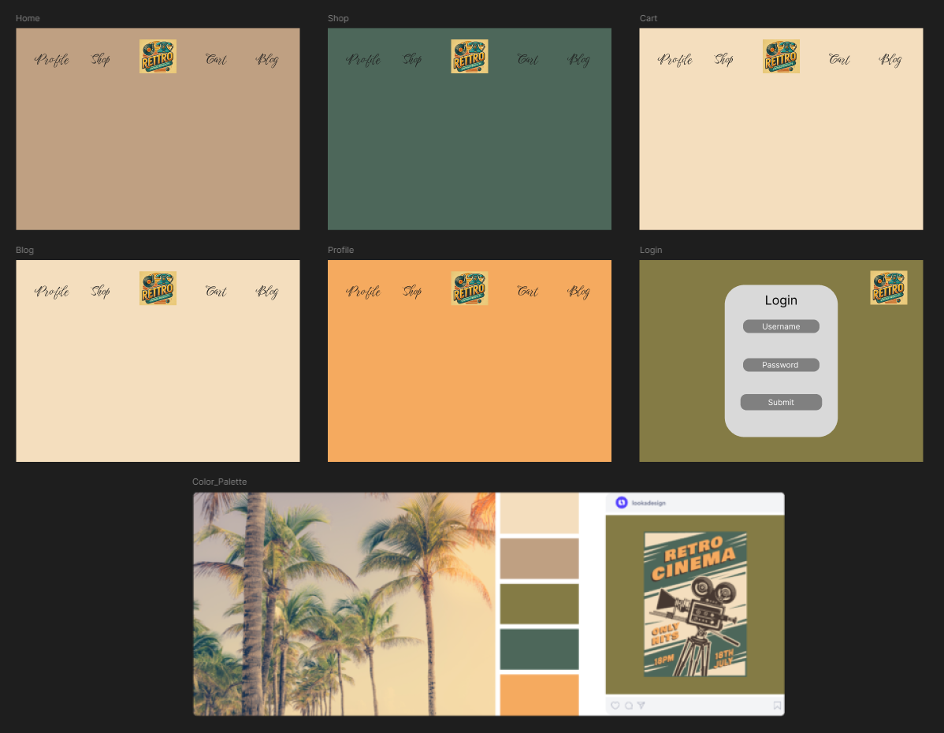
Figma Design plan
Here you can see our initial Figma Design plan and the corresponding colour palette

Slide 5
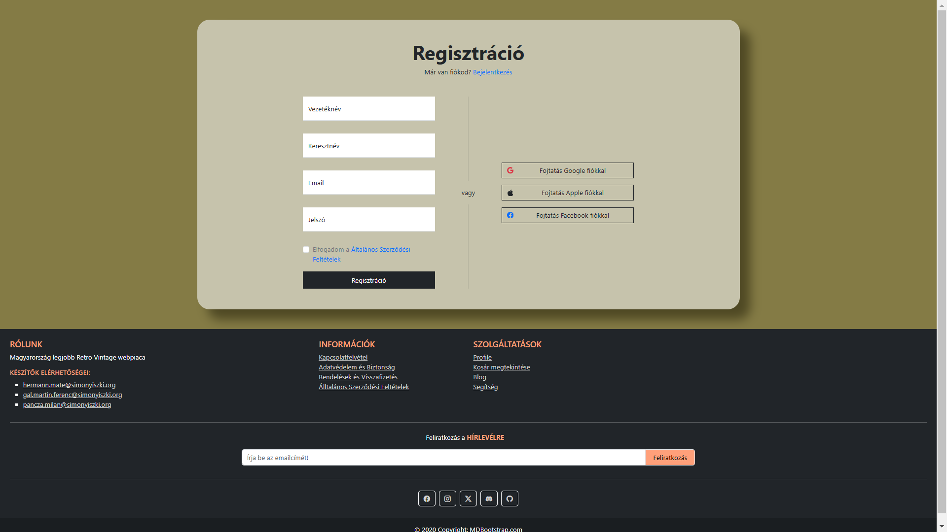
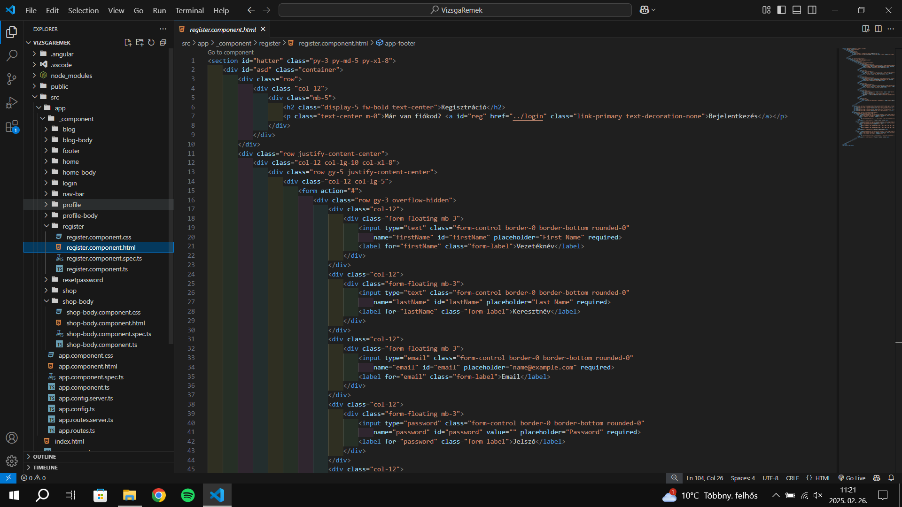
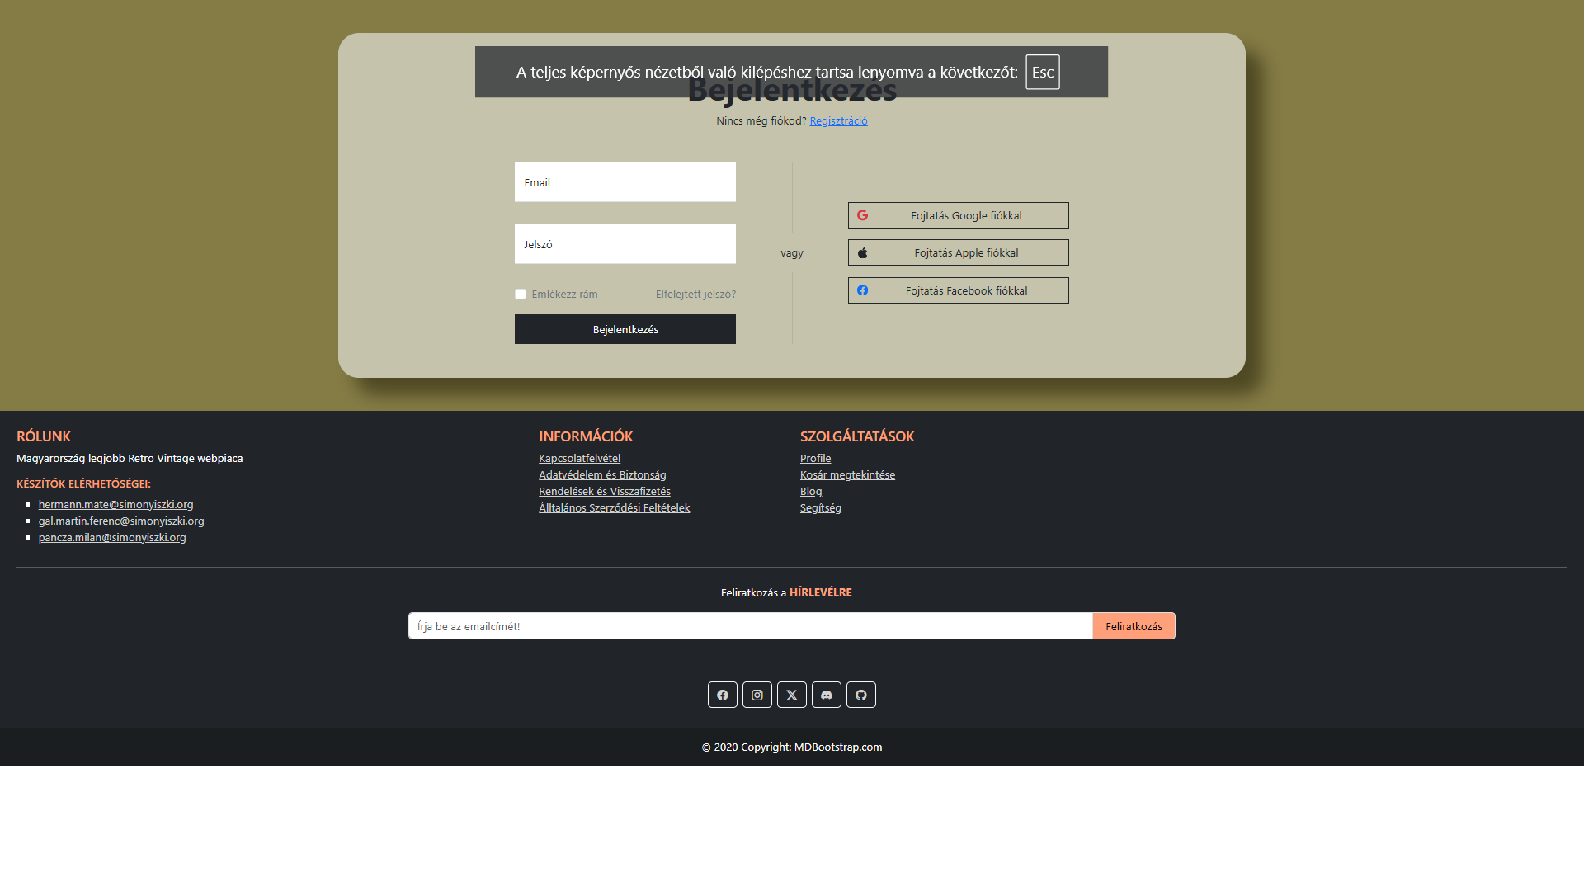
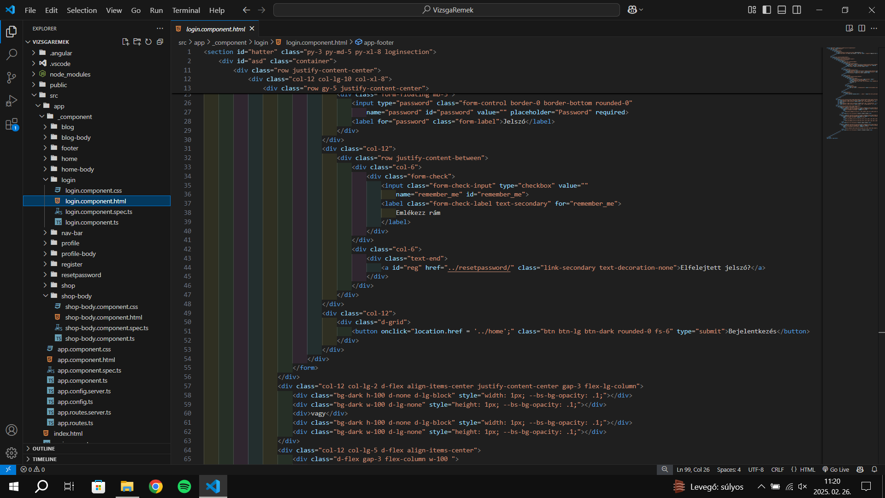
Register/Login
First round of a Register/Login website

Slide 6
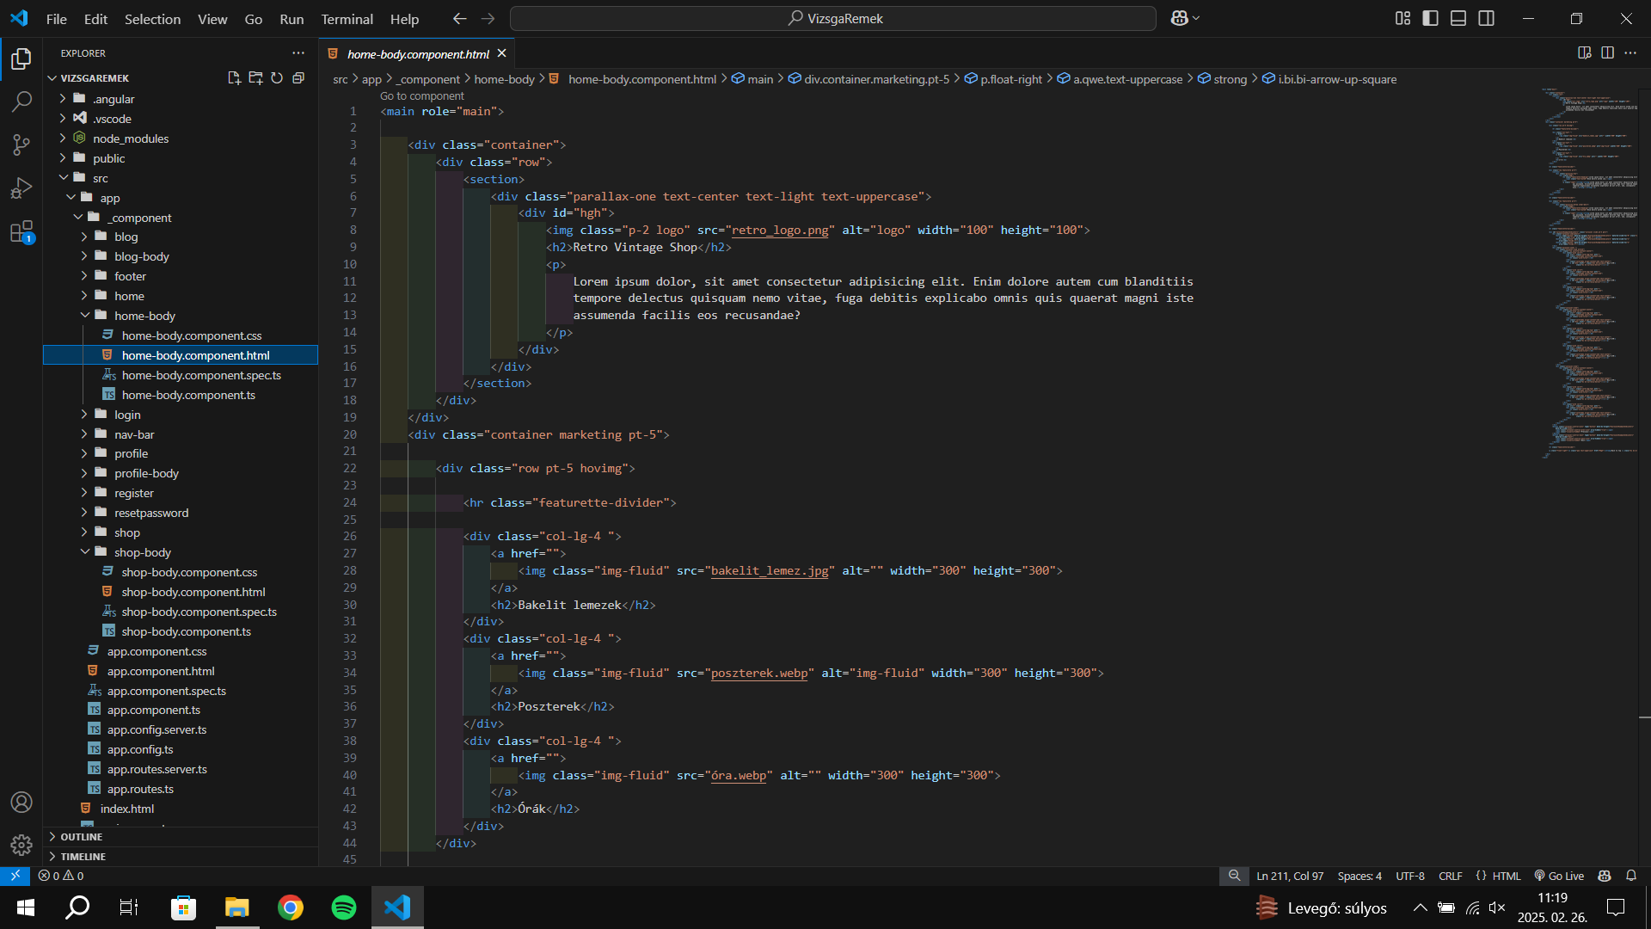
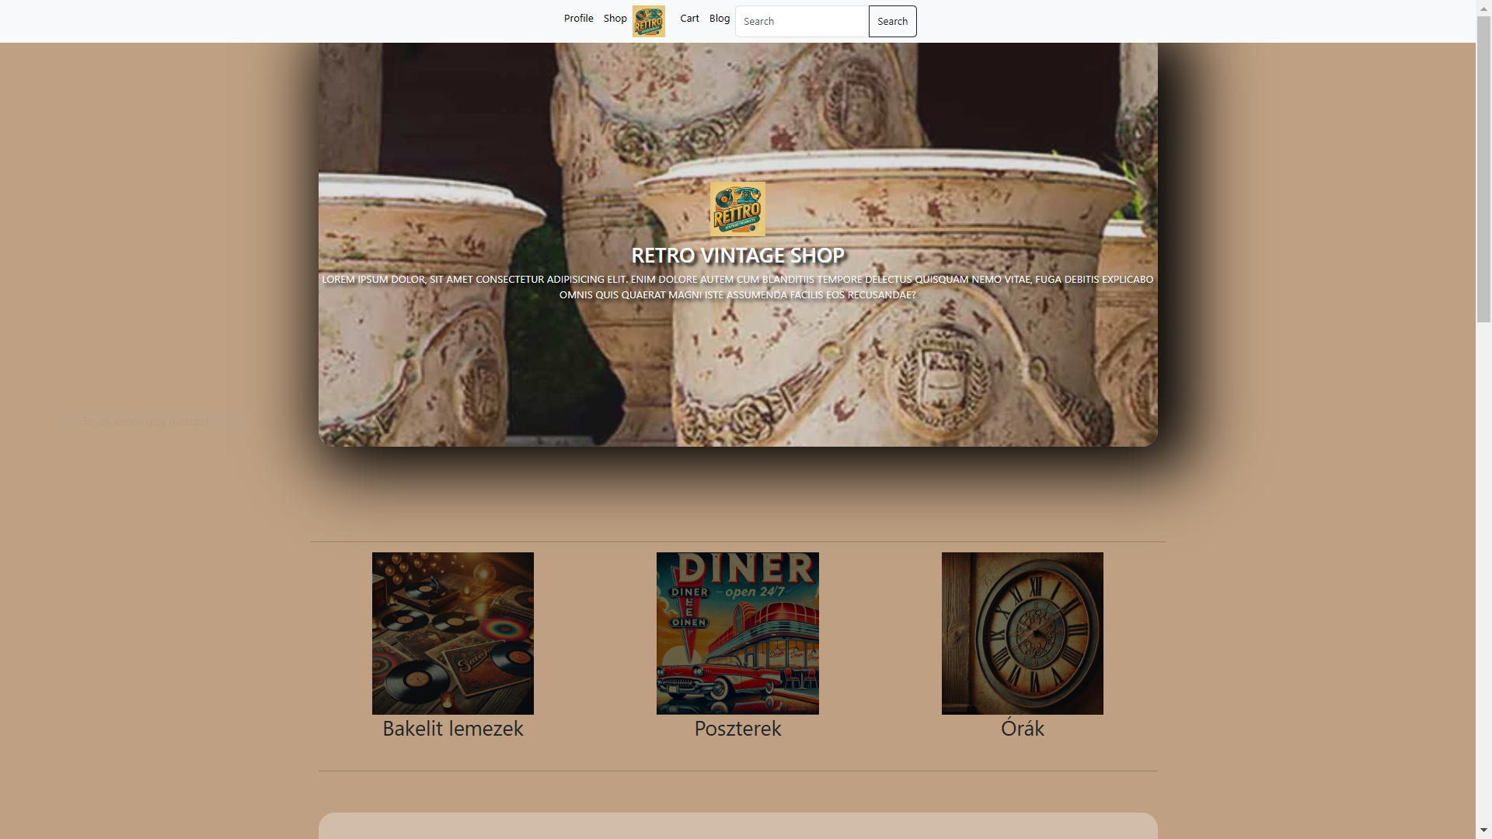
Home
This was followed by the Home page. Then the other pages that were added to the website.

Slide 7
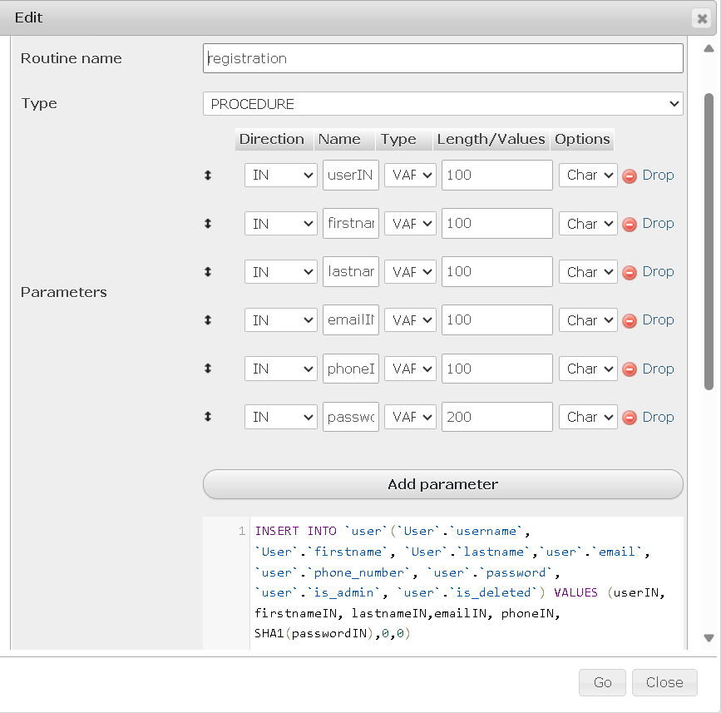
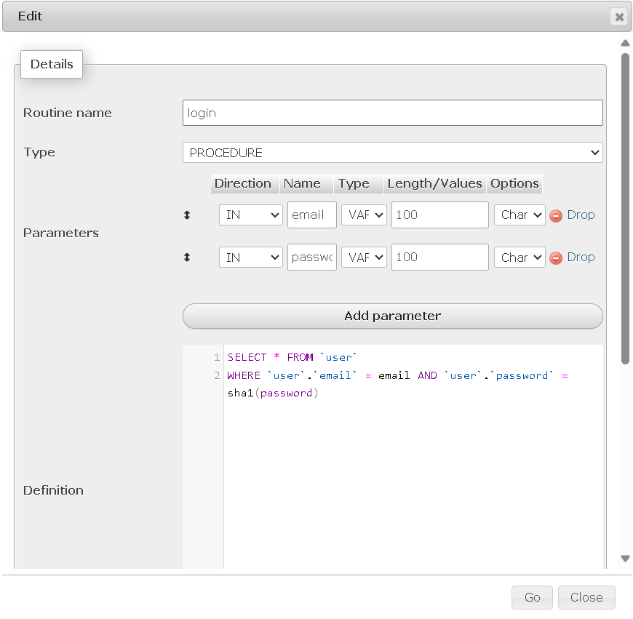
Database
Registration Stored Procedure
SHA-256 password hashing
An easy login Stored Procedure

Slide 8
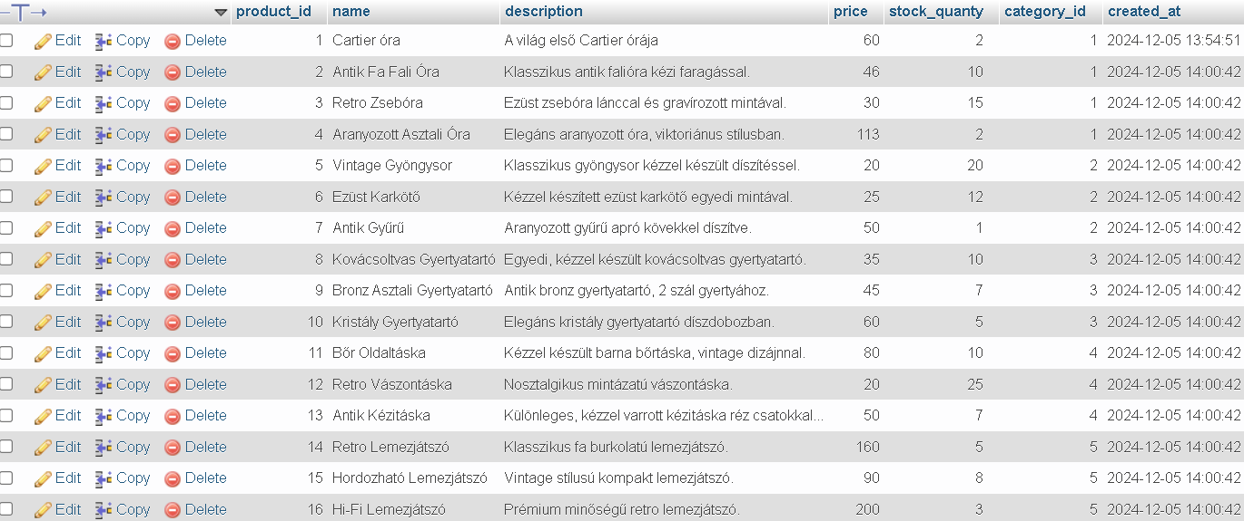
Database
It’s a sample about the products

Slide 9
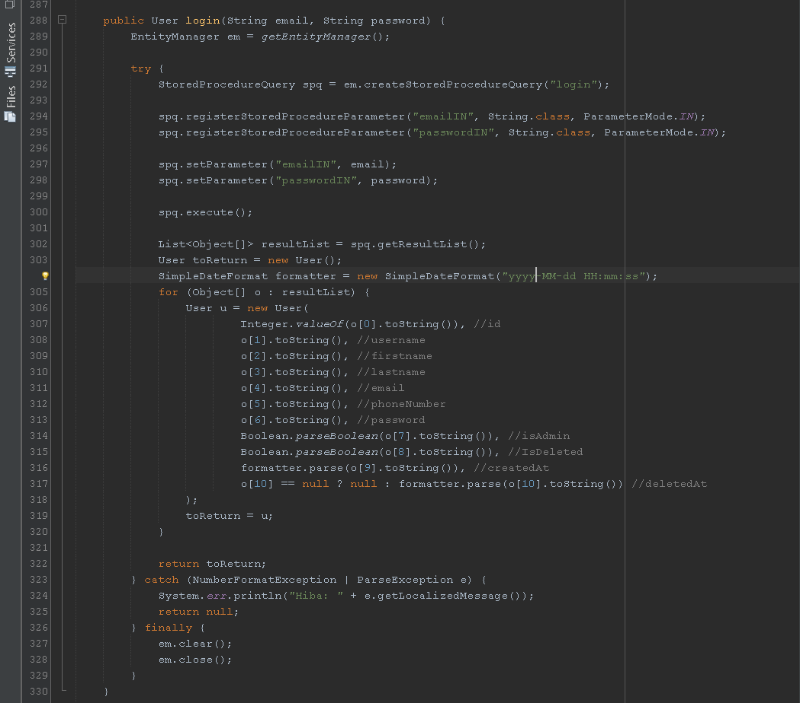
Backend
The Login method attempts to authenticate a user calling a stored procedure.
It takes an email and password as an input using JPA’s StoredProcedure

Slide 10
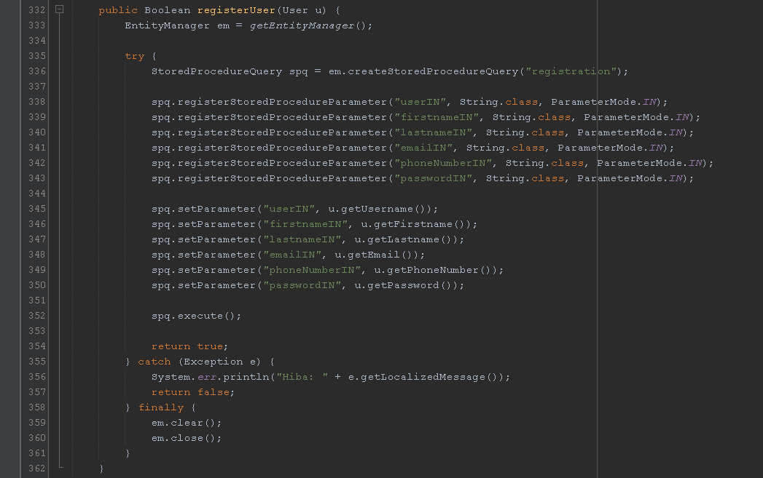
Backend
The registerUser method attempts to register the new user into the Database

Slide 11
Future plans
Future plans include the expansion of the database, registration/login through google and similar services. In addition, card and transfer payments will be possible.

Slide 12
Difficulties
The difficulty was, for example, which theme to choose. We didn't really have a good idea in the first round of what would get people's attention. Then we came up with the Retro theme, and that's how it all came together. In addition, there was also a difficulty in getting started. It took us a relatively long time to really get going.

Slide 13
Programmes used
Github
The codes were used to store
Visual Studio Code
Used to create the initial website
Java Netbeans
The Backend code was used to write
Angular
To write the finished frontend code we use
Discord
Used to communicate with members
Google Drive
Used to store and share larger files
MAMP-PhpMyAdmin
We used the following to create the database
Figma
The basic shape design was used

Slide 14
Summary
Here is the current state of our project: while documentation has taken a backseat for now, it has not been forgotten. We are developing this project because we have not found any competing websites that sell similar products in such large quantities.

Slide 15
Thank you for your attention!
Gál Martin
Hermann Máté
Pancza Milán
+36/50 124 6417
+36/70 408 8704
+36/20 250 0673
gal.martin@simonyiszki.org
hermann.mate@simonyiszki.org
pancza.milan@simonyiszki.org

